Slide 1


Final Project - Data Engineer
DigitalSkola
by Axel Ivanda Tanjung

Slide 2
Project Background
ETL Architecture Diagram
Tools
Table of Content
API Specification
Project Step
Airflow Output
Data Mart Output

Slide 3

Project Background
This final project is about Dockerize ETL Pipeline using ETL tools Airflow that extract
Public API data from PIKOBAR, then load into MySQL (Staging Area) and finally
aggregate the data and save into PostgreSQL.

Slide 4
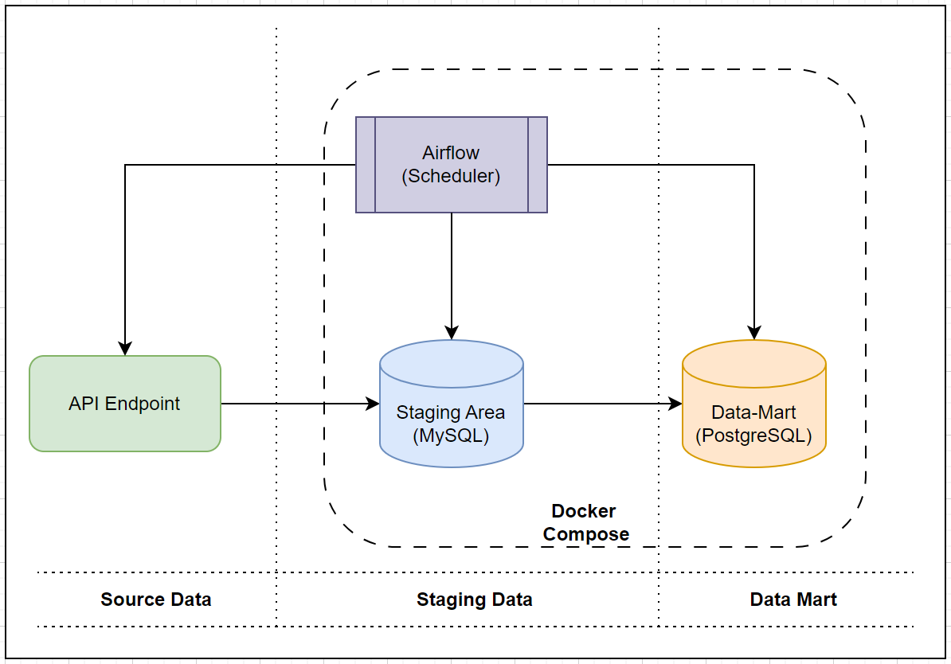
ETL Architecture Diagram

Slide 5








Tools

Slide 6
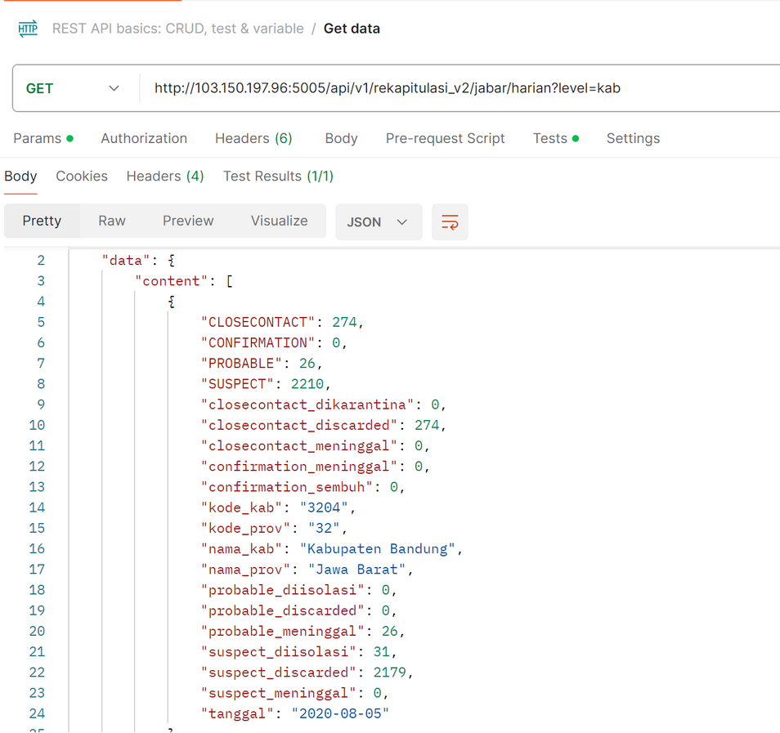

API Specification
API Endpoint : http://103.150.197.96:5005
Path : /api/v1/rekapitulasi_v2/jabar/harian
Content-Type : application/json
Request Parameter : {"level": "kab"}
Request method : GET

Slide 7
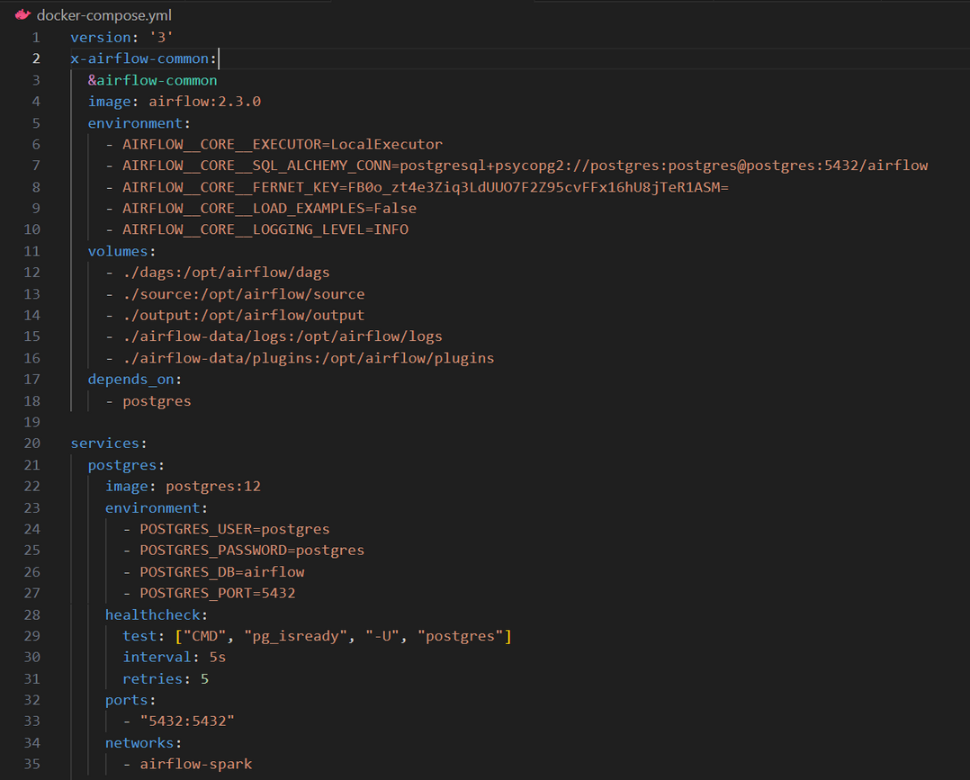
Project Step
Create Docker (MySQL, Airflow and PostgreSQL) in local computer
1. Define docker-compose.yml consist of:
airflow:2.3.0
airflow-init
airflow-scheduler
airflow-webserver
postgresql:12
mysql:latest
2. Define image, environtment, dependency, volume, port, network, etc in docker compose
3. Running “docker compose up” in terminal

Slide 8
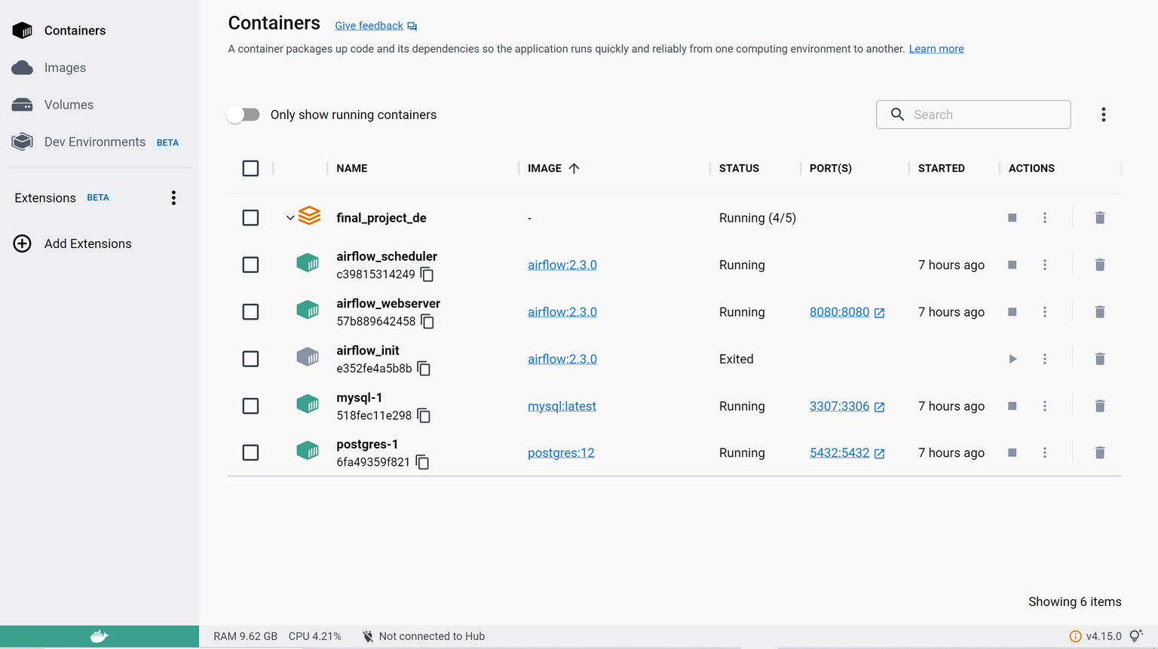
Project Step

Slide 9
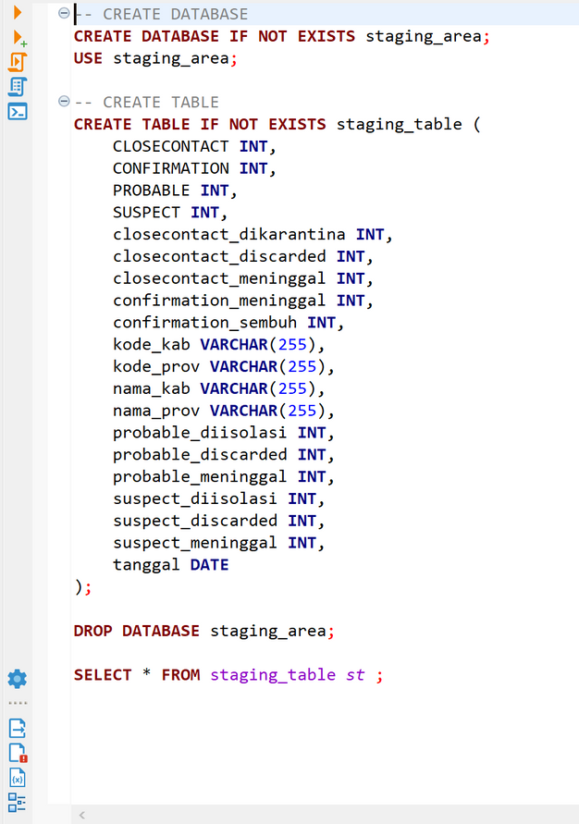
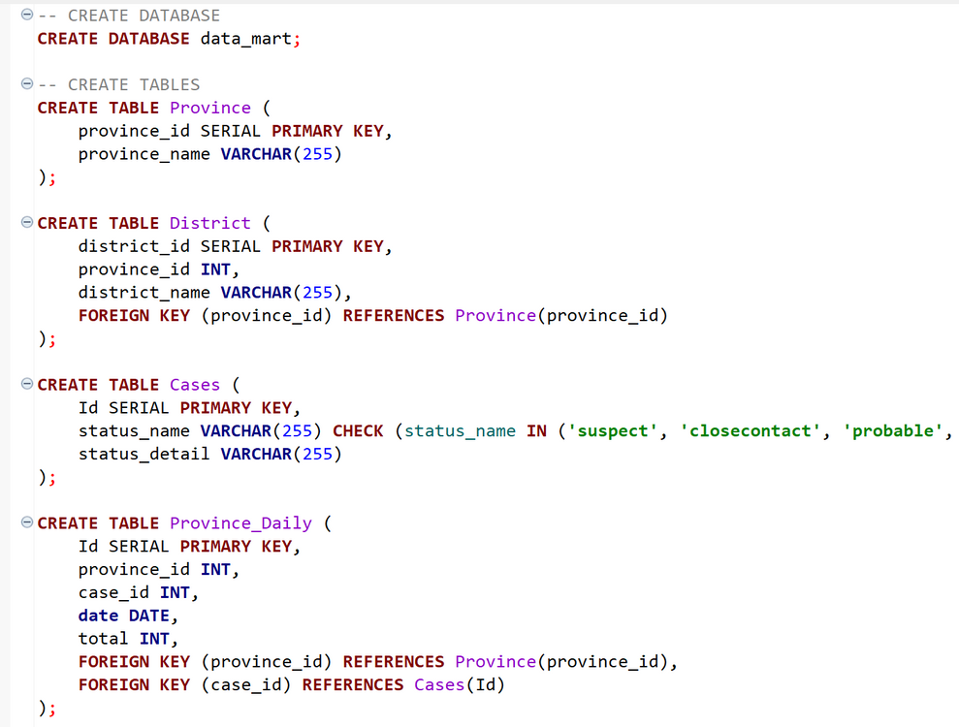
Project Step
Create Database in MySQL and PostgreSQL
Staging database in MySQL using as is schema like data source
Data mart in postgres using Fact Table and Dimension Table Schema

Slide 10
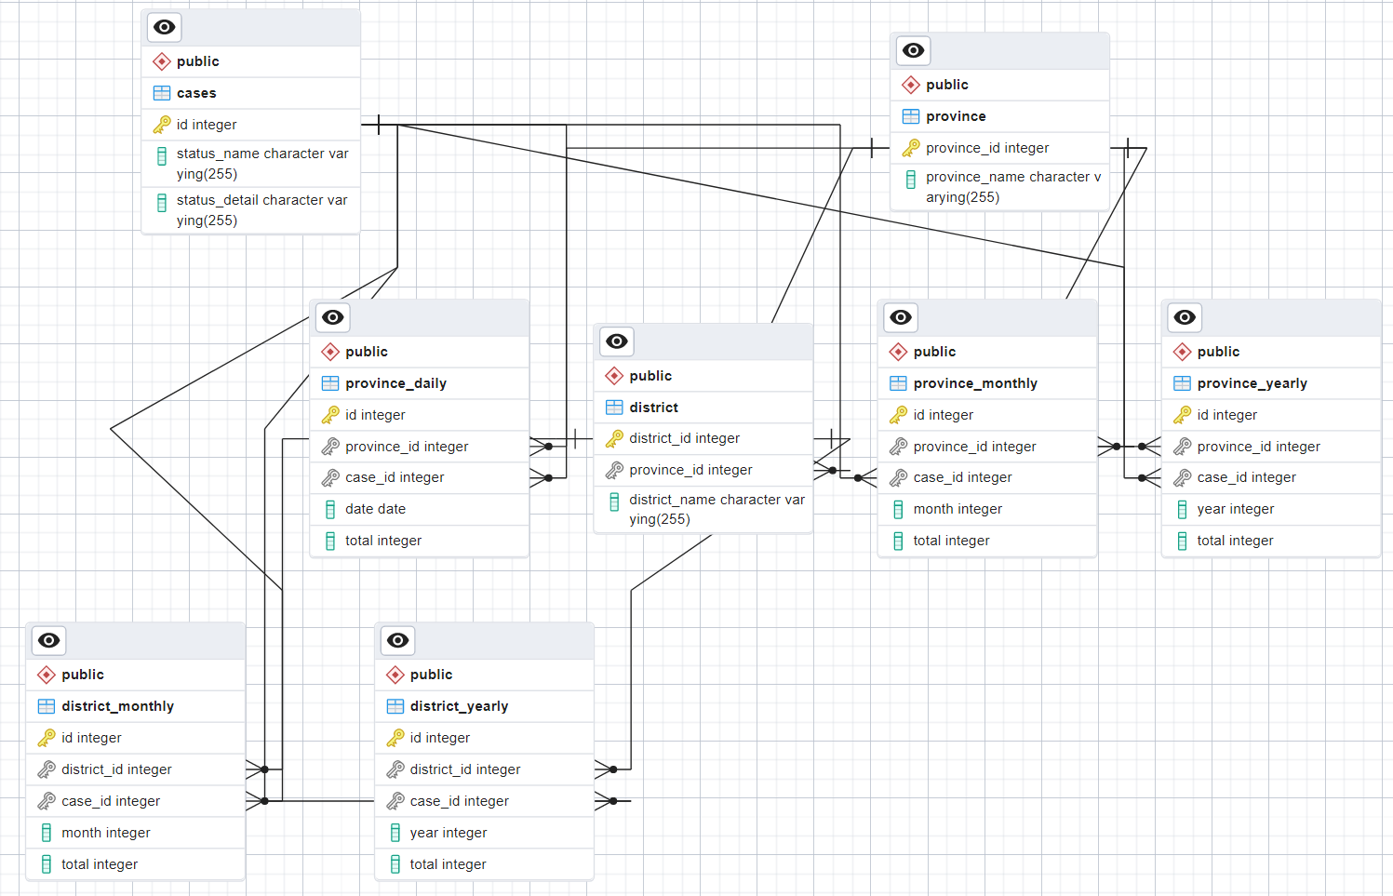
Project Step
Fact Table and Dimension Table Schema

Slide 11
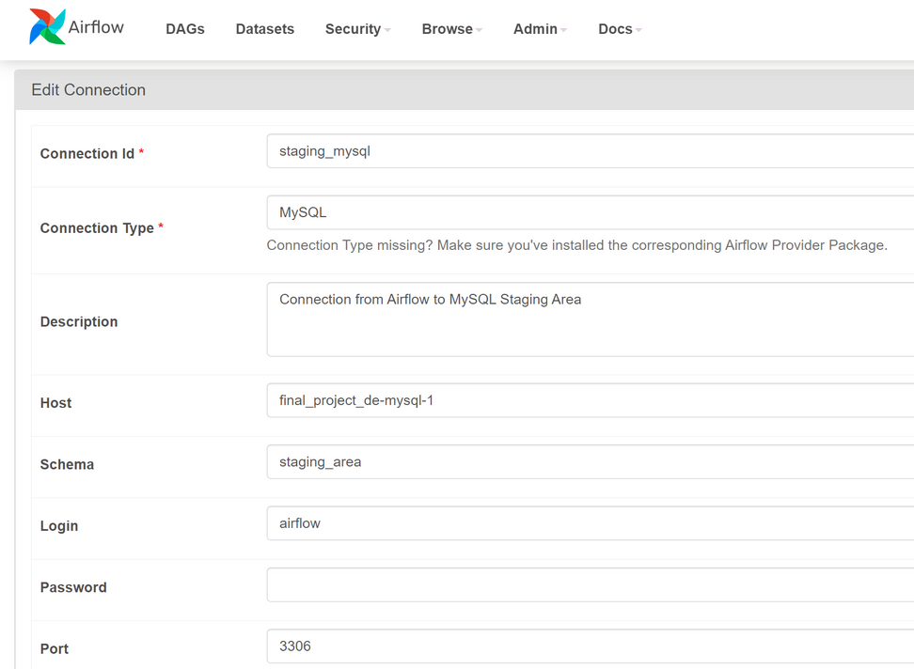
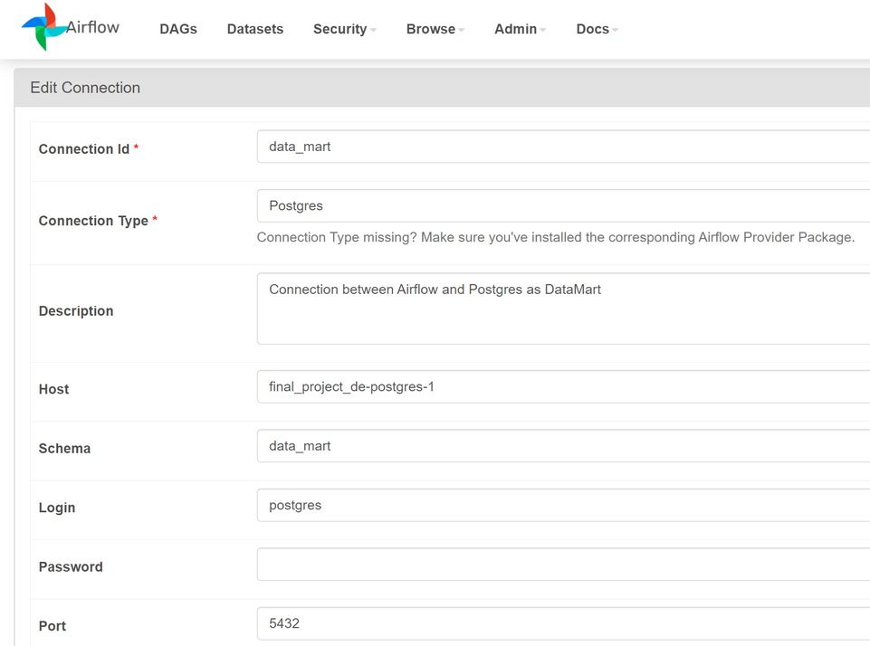
Project Step
Create Connection from Airflow to MySQL and PostgreSQL
Airflow to MySQL
Airflow to PostgreSQL

Slide 12
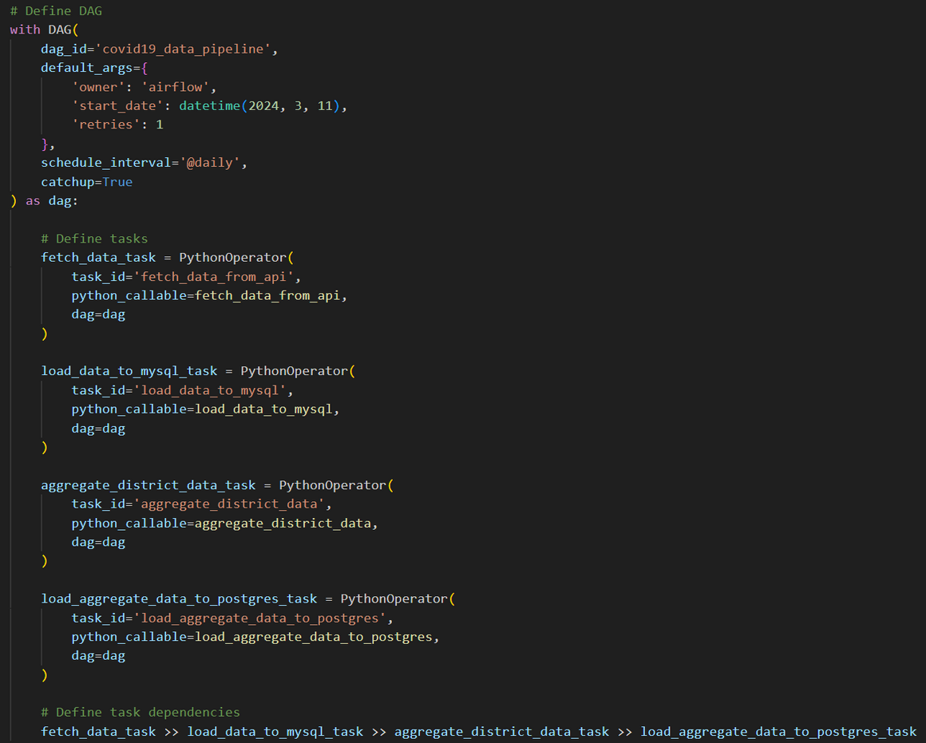
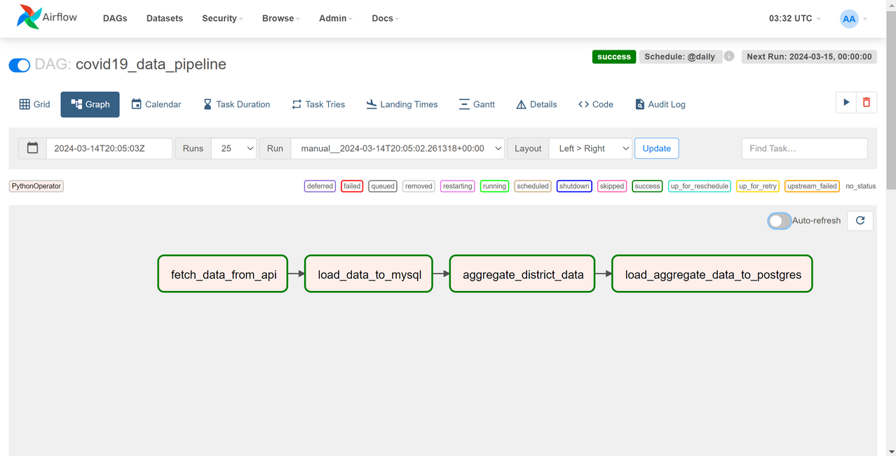
Project Step
Create Directed Acyclic Graph

Slide 13
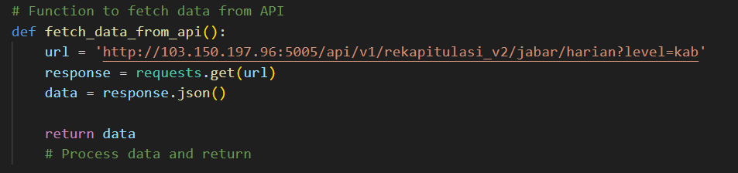
Project Step
Fetch Data from API

Slide 14
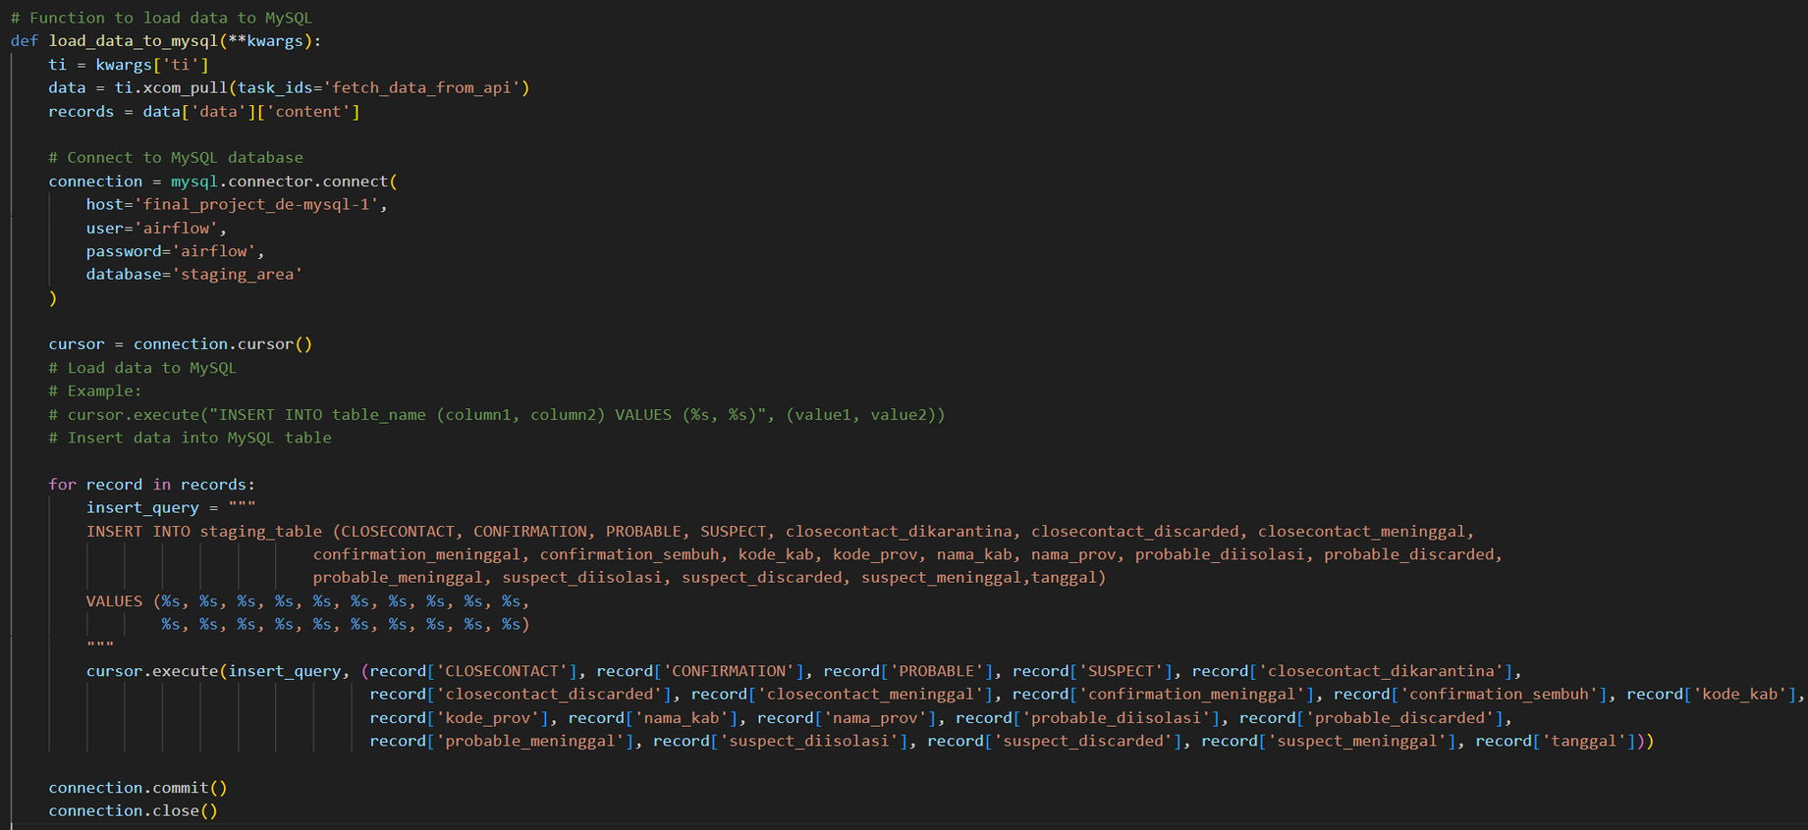
Project Step
Load Data to MySQL (Staging Area)

Slide 15
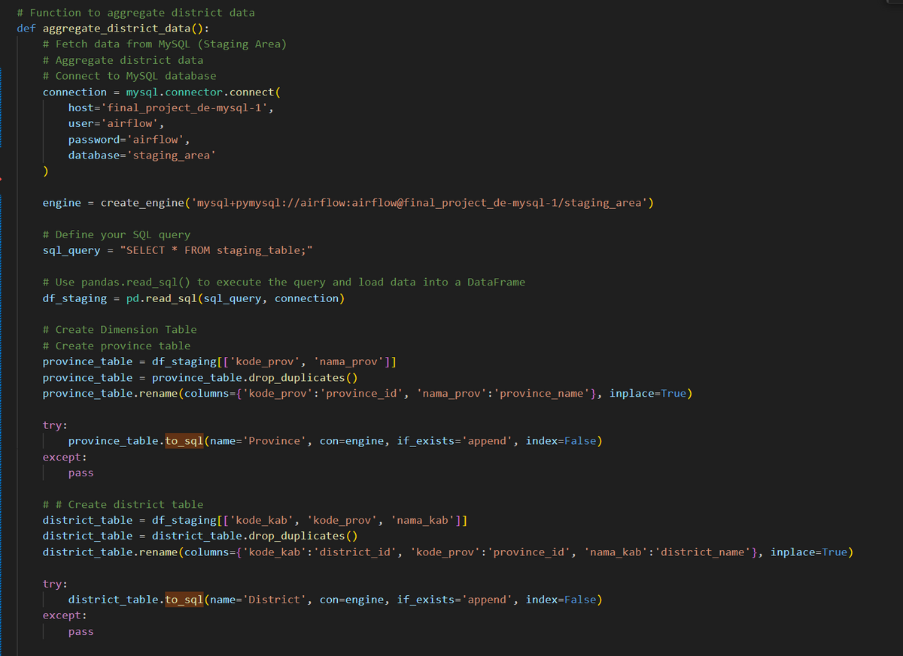
Project Step
Aggregate Data on Staging (Dimension Table) - Province & District

Slide 16
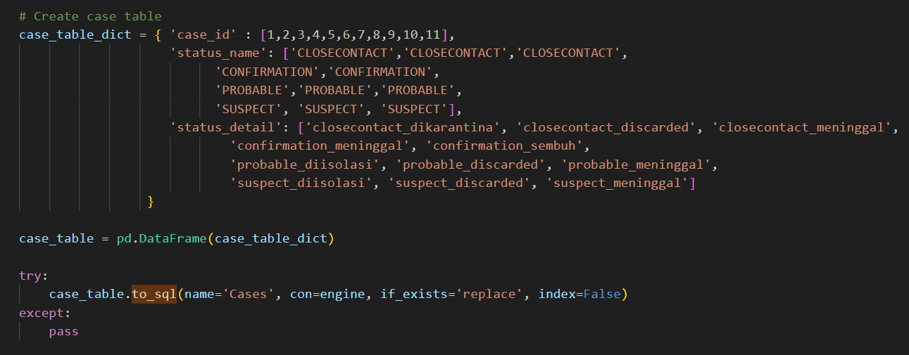
Project Step
Aggregate Data on Staging (Dimension Table - Case)

Slide 17
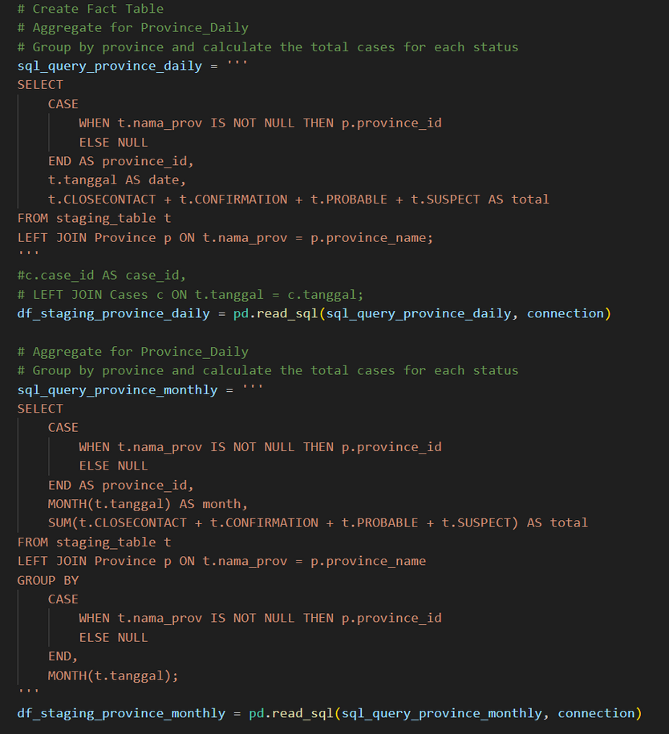
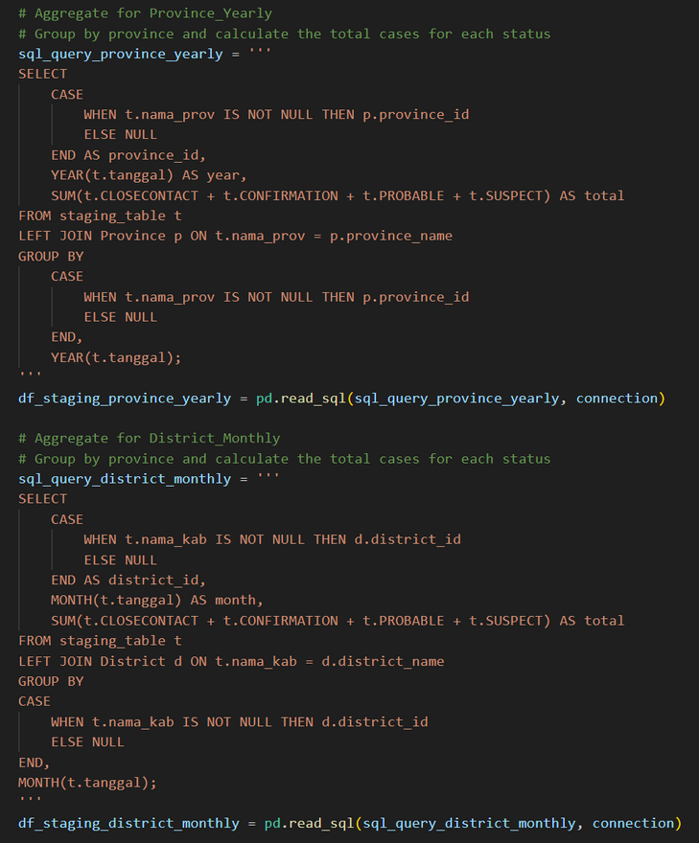
Project Step
Aggregate Data on Staging (Fact Table)

Slide 18
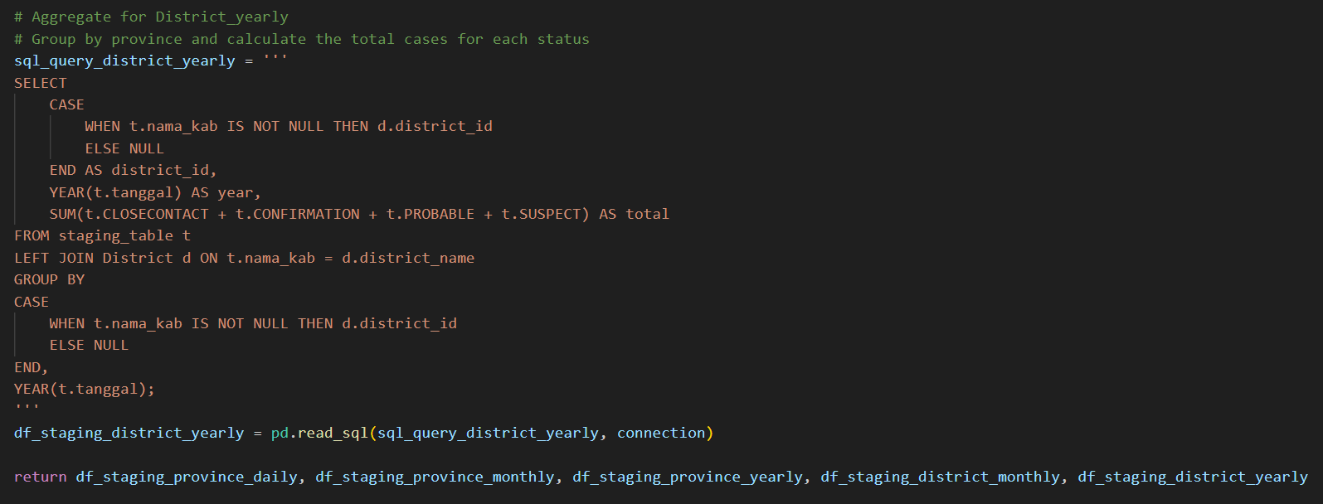
Project Step
Aggregate Data on Staging (Fact Table)

Slide 19
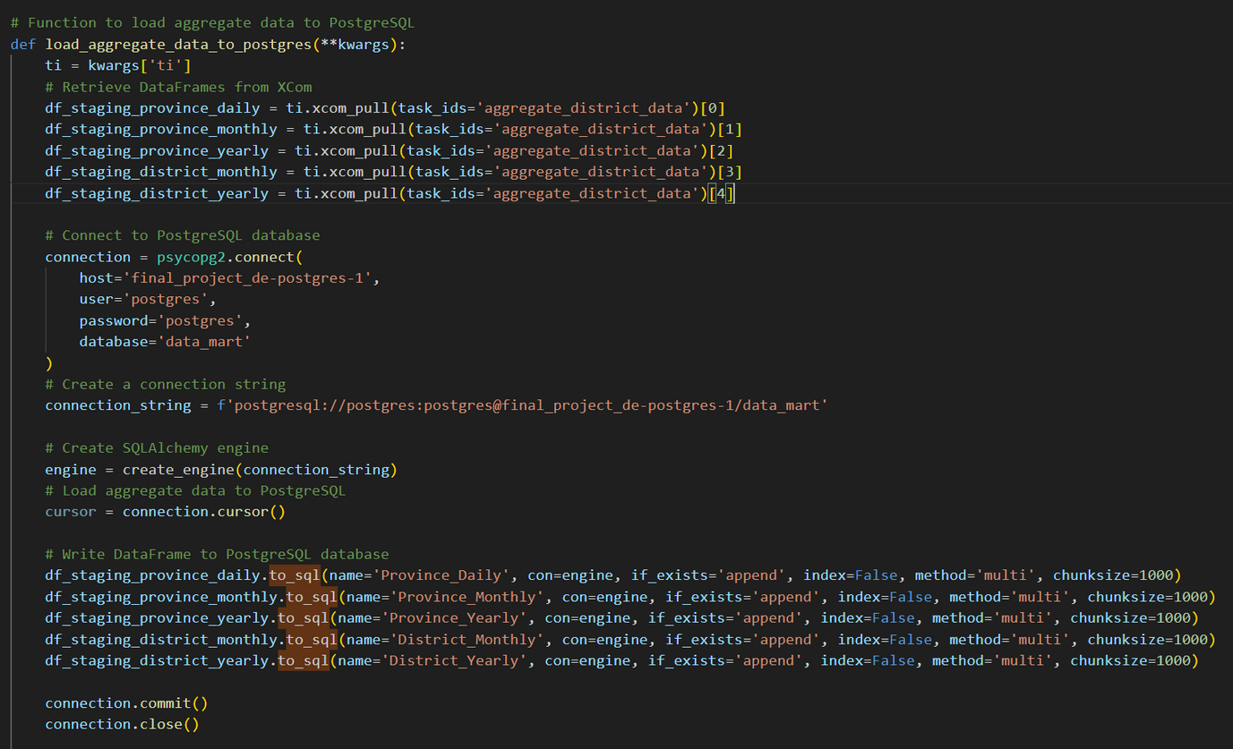
Project Step
Load Aggegate Data to Postgres

Slide 20
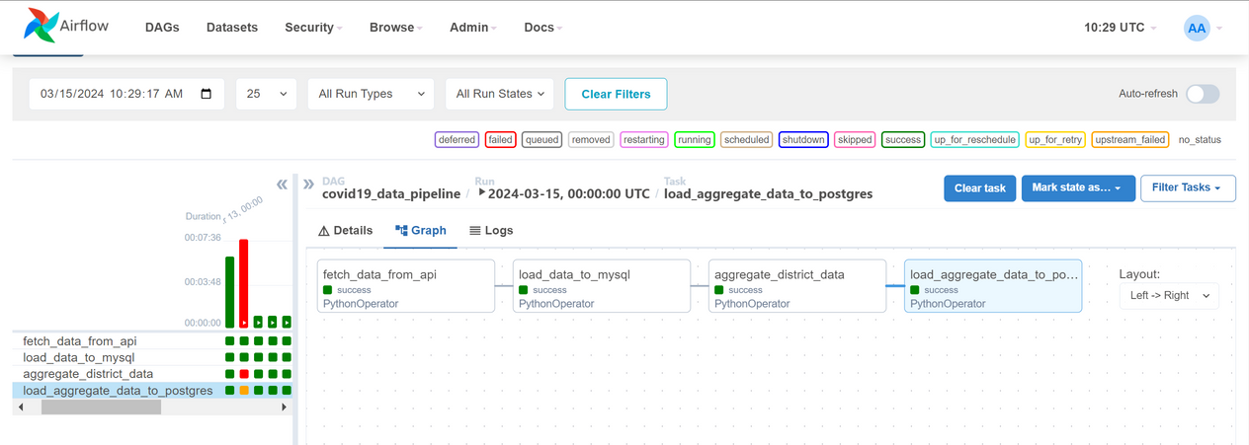
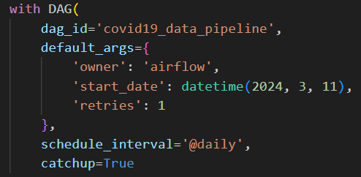
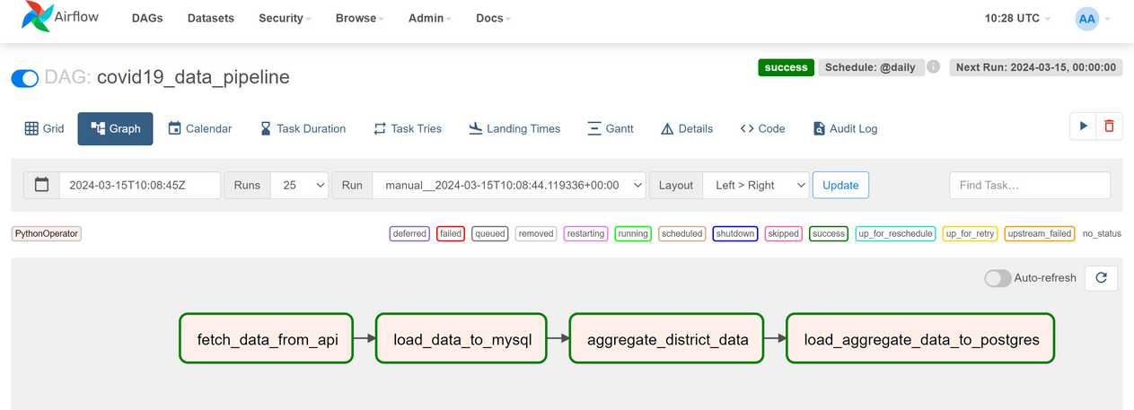
Airflow Output

Slide 21
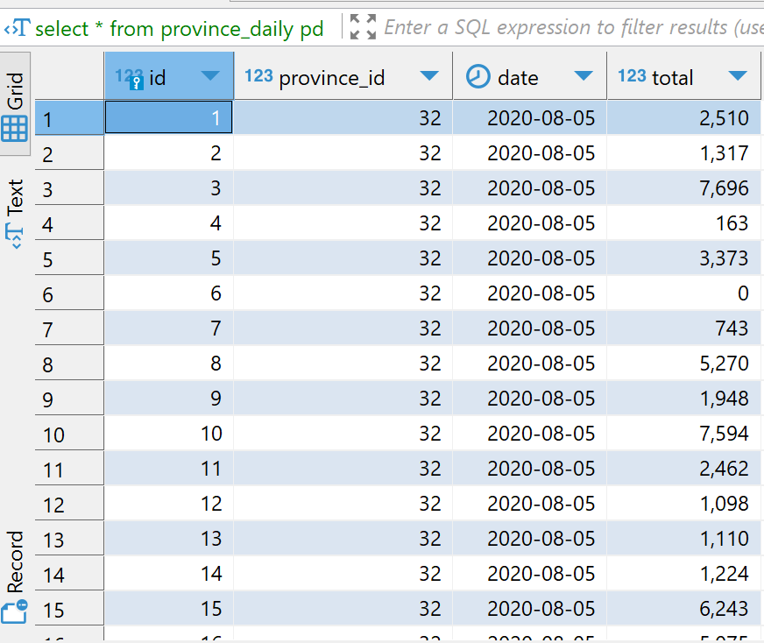
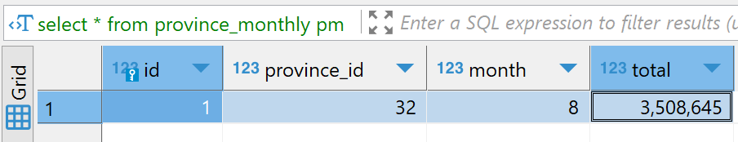
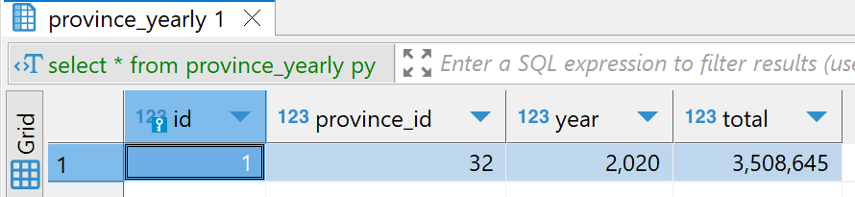
Data Mart Output
Output Table Province pada PostgreSQL

Slide 22
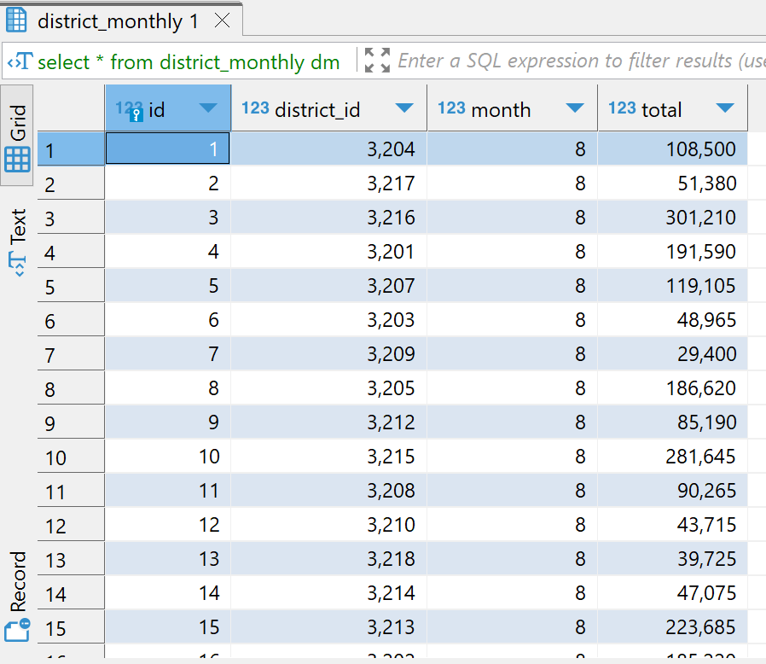
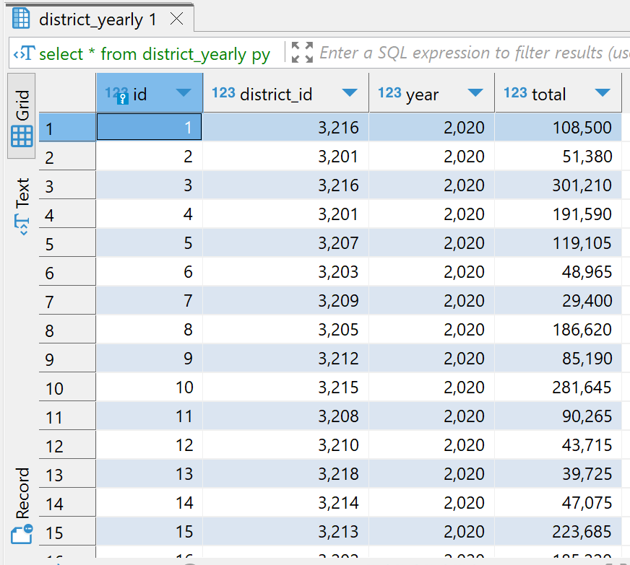
Data Mart Output
Output Table District pada PostgreSQL

Slide 23

Thank You!

